Slide 1
Merkle Trees

Slide 2
Background
Merkle trees are an algorithm that we have brushed over a few times now - it is extremely useful for efficiently calculated the differences between sets of data or files, and determining where they differ in logarithmic time (as opposed to linear time).
Like Bloom Filters, they heavily rely on hashing for their good performance, and we can see them being used in the Git revision system, anti entropy processes in leaderless databases, and also in blockchain/decentralized currencies.

Slide 3
Merkle Tree Basic Algorithm
a.txt
b.txt
c.txt
d.txt

Slide 4
Merkle Tree Basic Algorithm
a.txt
b.txt
c.txt
d.txt
h1z2
y77a
93pq
s345

Slide 5
Merkle Tree Basic Algorithm
a.txt
b.txt
c.txt
d.txt
h1z2
y77a
93pq
s345
h1z2
y77a
93pq
s345

Slide 6
Merkle Tree Basic Algorithm
a.txt
b.txt
c.txt
d.txt
u67r
fdc1
h1z2
y77a
93pq
s345
h1z2
y77a
93pq
s345

Slide 7
Merkle Tree Basic Algorithm
po73
a.txt
b.txt
c.txt
d.txt
u67r
fdc1
h1z2
y77a
93pq
s345
h1z2
y77a
93pq
s345

Slide 8
Merkle Tree Basic Algorithm
12m3
a.txt
b.txt
c.txt
d.txt
u67r
j34z
h1z2
y77a
4w12
s345
h1z2
y77a
4w12
s345
Now, make a change to c.txt!

Slide 9
Merkle Tree Comparison
12m3
po73
u67r
j34z
u67r
fdc1
h1z2
y77a
93pq
s345
h1z2
y77a
4w12
s345
Start from the root, and traverse depth first finding differences in the hashes!

Slide 10
Merkle Tree Comparison
12m3
po73
u67r
j34z
u67r
fdc1
h1z2
y77a
93pq
s345
h1z2
y77a
4w12
s345
Start from the root, and traverse depth first finding differences in the hashes!

Slide 11
Merkle Trees in Git
The way Merkle Trees are presented above means that they throw out all of the old hashes of files/chunks, but in Git we want persistence so that we can inspect old commits:
To fix this, each change to a file is treated as a separate file and hashed
If the hash is already in the merkle tree, nothing changes (good for file metadata changes)
If it is a new hash, add it as a leaf to the merkle tree and create a new branch/copy of the path from root to leaf
To go back in time to old commit, just start from the root hash of that commit

Slide 12
Merkle Trees in Cassandra
Recall: Anti-entropy is the background process of making sure that all replicas are consistent in a multi-master replication schema.
Cassandra uses Merkle trees for this! But wait, isn’t the data always changing? How can we be sure that the changes that one replica sends to another will still be valid by the time they travel over the network?

Slide 13
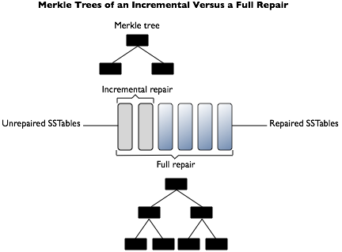
Incremental Read Repair
Recall: Cassandra uses immutable SSTable files. Hence, two replicas can easily perform comparison and anti-entropy in order to do this! In order to decrease duplicate data from being sent over the network, repaired SSTable files are marked as repaired, whereas ones that have not been marked as repaired are marked as unrepaired.
Incremental read repair allows us to send less data over the network, because the Merkle Trees are smaller!
In order to avoid having to repair SSTables that have already gone through the anti-entropy process, we separately compact repaired tables and unrepaired tables! (Size tiered compaction)

Slide 14
Conclusion
Merkle trees are a very clever way of detecting the differences between large sets of records by using a logarithmic tree of hashes. They are extremely applicable in multiple areas of systems design, such as detecting the differences in files, as well as finding the smallest units of difference in order to propagate them over the network, such as in anti-entropy.

